Slide 1
WiFi Training
KS, 5/21/2012

Slide 2
Topics
The View from 30,000 feet
Joining a Network
MAC Frames – Session 1
AirPcap – Session 1
MAC Frames – Session 2
AirPcap – Session 2
MAC Frames – Session 3
Security
PHY
RF
Case Studies

Slide 3
The View from 30,000 feet

Slide 4
Overview
Wireless LAN in real world
Standards & Technologies
Protocol Map
Differences between wired and wireless
Common problems

Slide 5
WLAN in Real World
“Ethernet is dead” (2012)
“Wireless networks are an excellent complement to fixed networks” (2005)

Slide 6
Standards
Relationship with 802
Relationship with 802.3

Slide 7
Standards
Timeline: http://grouper.ieee.org/groups/802/11/Reports/802.11_Timelines.htm
802.11-2007
802.11a-1999: 5 GHz, 54 Mbps
802.11b-1999: 2.4 GHz, 11 Mbps
802.11g-2003: 2.4 GHz, 54 Mbps
802.11n-2009: 2.4/5 GHz, N*150 Mbps

Slide 8
More Standards
802.11i: Security
802.11h: Spectrum & TX power management
802.11e: QoS
802.11d: International roaming
and more …

Slide 9
802.11n Technologies
OFDM – multiple subcarriers
MIMO – multiple spatial streams
HT-40 – 2x20 MHz channel width
Others
Aggregation
BlockACK

Slide 10
Protocol Map

Slide 11
Wireless vs. Wired
Need a connection process
Half-duplex
High error rate, so retransmission is required
Channel capacity is shared by everyone
Can be easily sniffed, jammed, cracked, …
High power consumption
Lower throughput

Slide 12
Common Complaints
“Which AP? What is the password?”
“I can’t connect …”
“The connection is not stable …”
“My network is SLOW …”
“Skype quality is really bad …”
“Battery couldn’t last overnight …”
“… I still can’t connect …”

Slide 13
Joining a network

Slide 14
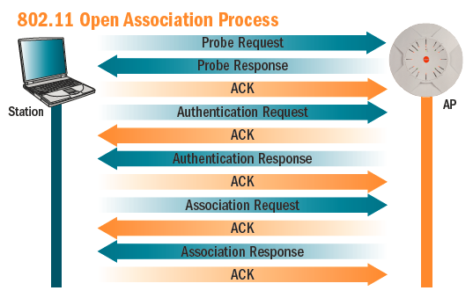

Slide 15
What’s in a Network?
Other Stations
APs
Bridging service
Distribution System

Slide 16
Re-joining a Network
Basic Service Set (BSS)
Extended Service Set (ESS)
SSID

Slide 17
MAC frames – session 1

Slide 18
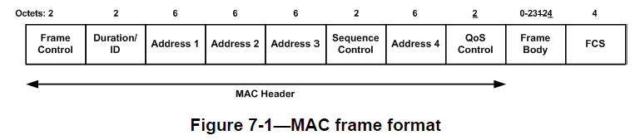
General Frame Format
Optional

Slide 19
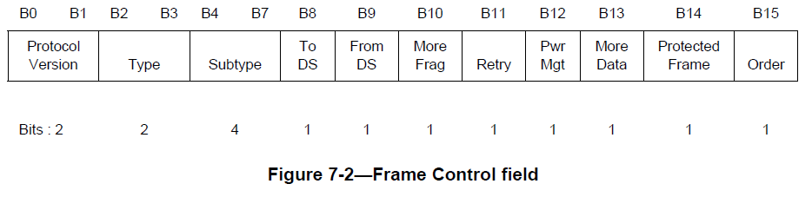
Frame Control Field
b3 b2 | Type
00 | Management
01 | Control
10 | Data

Slide 20
Watch Out for the Bit-Ordering !
Standards documents use
Little-Endian in diagrams
Big-Endian in descriptions
Wireshark
Always uses big-Endian

Slide 21
3 Types of MAC Frames
Management frames
Beacon, Probe Request, Probe Response, …
Association, Disassociation, …
Data frames
Control frames
ACK, …

Slide 22
Data
Data

Slide 23
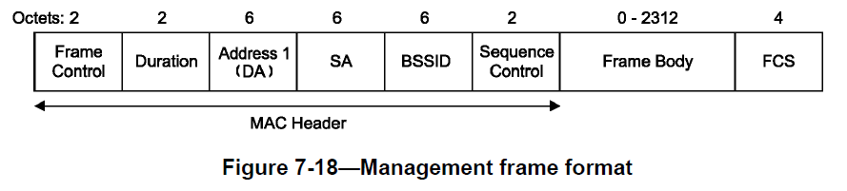
Management Frame

Slide 24
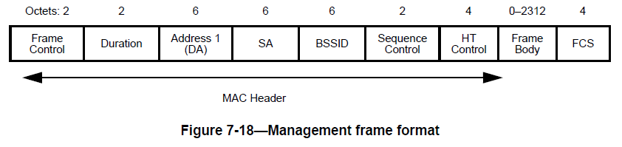
Management Frame – 802.11n

Slide 25
Mgmt Frame Body Components
Fields
Fixed length
Fixed order
Information Elements (IE)
Variable length
Relative order

Slide 26
Example: Beacon
Fixed fields
Timestamp (8-byte)
Beacon Interval (2-byte)
Capability (2-byte)
IE’s
SSID
Supported Rates
TIM
…

Slide 27
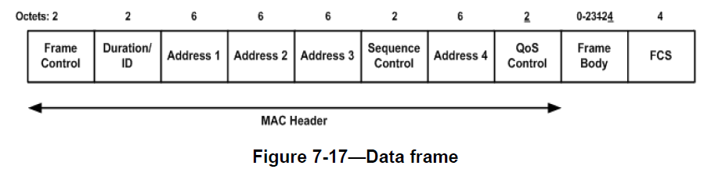
Data Frame

Slide 28
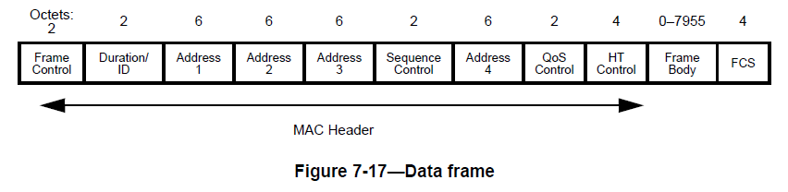
Data Frame – 802.11n

Slide 29
Data Frame with No Data
“Null Function”
Used for
Keep alive
Notify power save condition

Slide 30
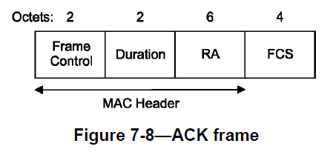
Control Frame - ACK

Slide 31
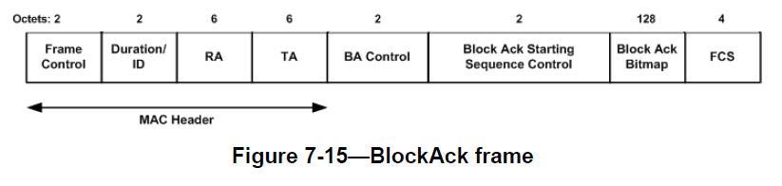
Control Frame - BlockAck

Slide 32
Airpcap – session 1

Slide 33
AirPcap – Wireless Sniffer
Capture – select interface and channel
Display filter

Slide 34
Problems with Wireless Sniffing
You (the sniffer) may not be able to hear it
You may not be able to hear it correctly
You may not hear all of the packets
Replace “you” with “they (receivers)”

Slide 35
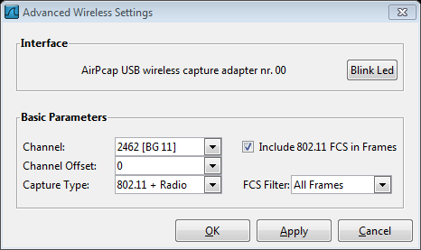
Interface & Channel

Slide 36

Packet Capture
Live exercises
Scan, connect, ping & suspend –

Slide 37
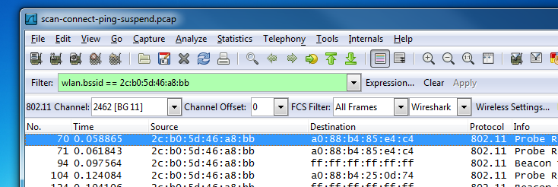
Display Filter
We are only interested in packets within our network
wlan.bssid == 2c:b0:5d:46:a8:bb

Slide 38
Which BSSID?
root@android:/ # wpa_cli status
Using interface ‘wlan0’
bssid=2c:b0:5d:46:a8:bb
ssid=ksap-2g
id=1
mode=station
pairwise_cipher=NONE
group_cipher=NONE
key_mgmt=NONE
wpa_state=COMPLETED
ip_address=192.168.2.111
address=28:ef:01:0e:af:b7

Slide 39
Display Filter
We are only interested in packets within our network
Management frames only
(wlan.bssid == 2c:b0:5d:46:a8:bb) && (wlan.fc.type == 0x0)

Slide 40
Display Filter
We are only interested in packets within our network
Management frames only
But do not include Beacons
(wlan.bssid == 2c:b0:5d:46:a8:bb) && (wlan.fc.type == 0x0) && (wlan.fc.type_subtype != 0x8)

Slide 41
Mac frames – session 2

Slide 42
Management Frames
Beacons, BSSID
Probe request, response
Association
Disassociation

Slide 43
Management Frame – 802.11n
HT Control: optional

Slide 44
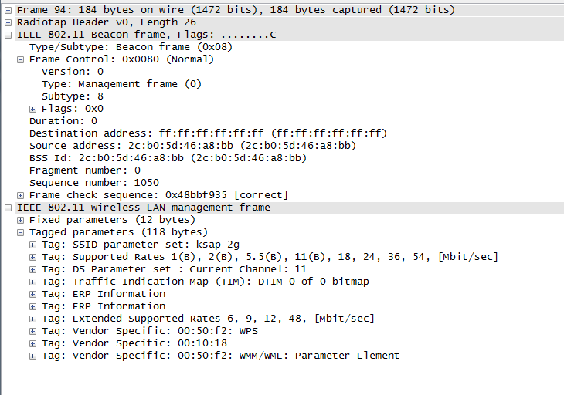
Beacon

Slide 45
What to look for in Beacon?
BSSID
Capabilities Information
SSID
RSN
TIM and DTIM
HT Capabilities
HT Information

Slide 46
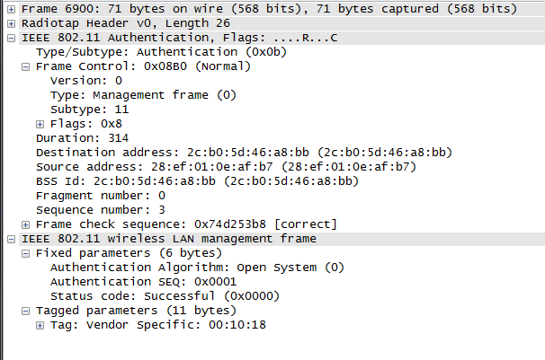
Authentication Request

Slide 47
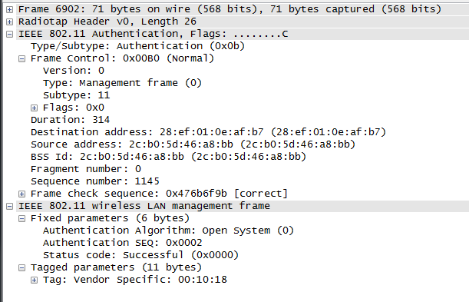
Authentication Response

Slide 48
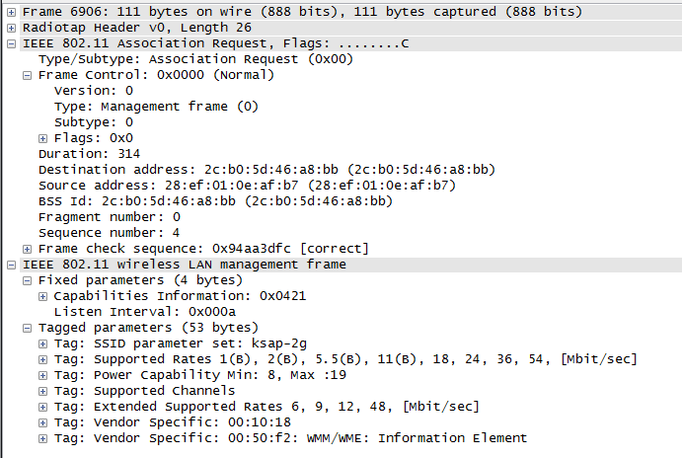
Association Request

Slide 49
What to look for in Assoc Req?
BSSID
Capabilities Information
SSID
RSN Information

Slide 50
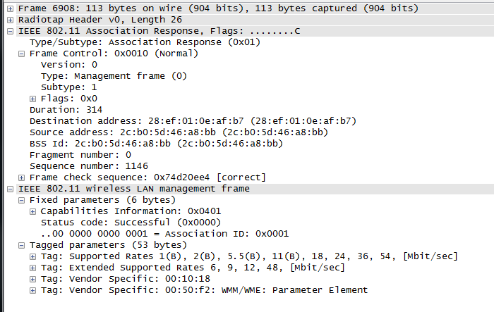
Association Response

Slide 51
What to look for in Assoc Resp?
Status code
Association ID

Slide 52
Data Frame – 802.11n

Slide 53
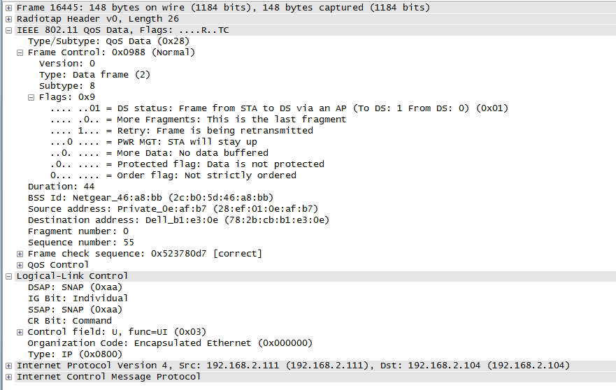
Data

Slide 54
What to look for in Data?
Frame Control/Flags
To or from DS?
Retry?
Sequence number
FCS

Slide 55
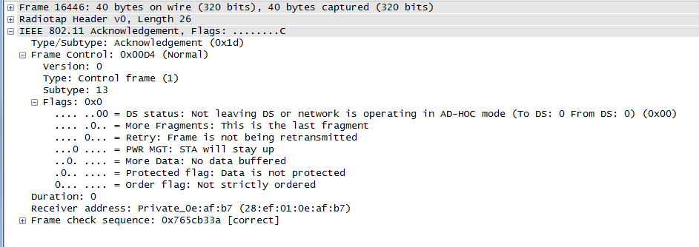
Control Frame - ACK

Slide 56
What to look for in ACK?
Receiver Address

Slide 57
Airpcap – session 2

Slide 58
AirPcap – Session 2
Display filter macro
Capture filter
Sniffing 40 MHz channel with AirPcap

Slide 59
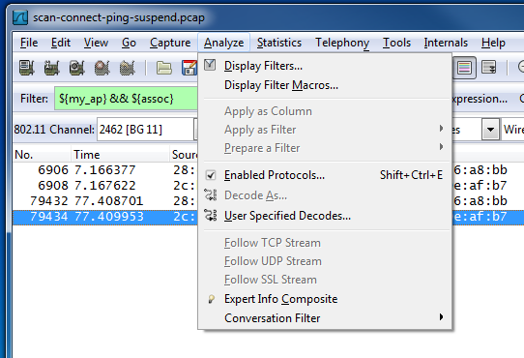
Display Filter Macros

Slide 60
Display Filter Macros
Macro name : definition
my_bssid
(wlan.bssid == 2c:b0:5d:46:a8:bb)
beacon
(wlan.fc.type_subtype == 0x08)
mgmt
(wlan.fc.type == 0x00)

Slide 61
Display Filter Using Macros
We are only interested in packets within our network
Management frames only
But do not include Beacons
${my_bssid} &&
${mgmt} &&
!${beacon}

Slide 62
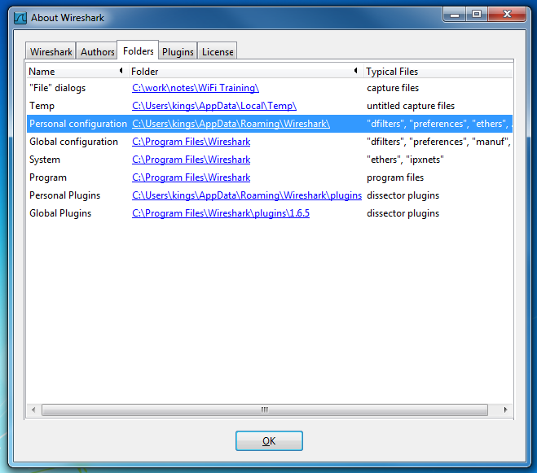
Saved Filters and Macros

Slide 63
Capture Filter
Wireshark / TShark
libwireshark
Tree
Dissectors
Plugins
Display filters
libwiretap
dumpcap
libwiretap
WinPcap / libpcap
Live data
Capture file

Slide 64
Capture Filter
We are only interested in packets between the AP and us
But something is missing …
(wlan host 2c:b0:5d:46:a8:ba) ||
(wlan host 28:ef:01:0e:af:b7)
Notes:
http://www.lovemytool.com/blog/2010/07/wireshark-wireless-display-and-capture-filters-samples-part-2-by-joke-snelders.html

Slide 65
BPF: “wlan host 2c:b0:5d:46:a8:ba”
Compiled BPF:
(000) ldb [3]
(001) lsh #8
(002) tax
(003) ldb [2]
(004) or x
(005) st M[0]
(006) tax
(007) ldb [x + 0]
(008) jset #0x4 jt 40 jf 9
(009) jset #0x8 jt 10 jf 31
(010) ldb [x + 1]
(011) jset #0x2 jt 12 jf 21
(012) jset #0x1 jt 13 jf 17
(013) ld [x + 26]
(014) jeq #0x5d46a8ba jt 15 jf 27
(015) ldh [x + 24]
(016) jeq #0x2cb0 jt 39 jf 27
(017) ld [x + 18]
(018) jeq #0x5d46a8ba jt 19 jf 35
(019) ldh [x + 16]
(020) jeq #0x2cb0 jt 39 jf 35
(021) ld [x + 12]
(022) jeq #0x5d46a8ba jt 23 jf 25
(023) ldh [x + 10]
(024) jeq #0x2cb0 jt 39 jf 25
(025) ldb [x + 1]
(026) jset #0x1 jt 27 jf 35
(027) ld [x + 18]
(028) jeq #0x5d46a8ba jt 29 jf 40
(029) ldh [x + 16]
(030) jeq #0x2cb0 jt 39 jf 40
(031) ld [x + 12]
(032) jeq #0x5d46a8ba jt 33 jf 35
(033) ldh [x + 10]
(034) jeq #0x2cb0 jt 39 jf 35
(035) ld [x + 6]
(036) jeq #0x5d46a8ba jt 37 jf 40
(037) ldh [x + 4]
(038) jeq #0x2cb0 jt 39 jf 40
(039) ret #65535 // Accept
(040) ret #0 // Ignore
jset: bit-wise AND
[x + 0]: first byte of 802.11 MAC frame
(008) says: If this is a Control frame (b2 == 1), ignore it (jt 40)

Slide 66
Sniffing 40 MHz Channel
There seem to be some problems with AirPcap at 40 MHz channel
Limited success:
AP channel | 36 | 40
wl status: channel spec | 38 (40 MHz) | 38 (40 MHz)
control channel | 36 | 40
Wireshark channel | 36 | 36
Wireshark channel offset | +1 | +1

Slide 67
Mac frames – session 3

Slide 68
MAC Frames (3)
Unicast, multicast, broadcast
ACK, Block-ACK
Power management

Slide 69
Unicast, Multicast & Broadcast
Unicast requires acknowledgement
Multicast & Broadcast can not be acknowledged

Slide 70
ACK
Why is there no sequence number?
Why is there no source address?

Slide 71
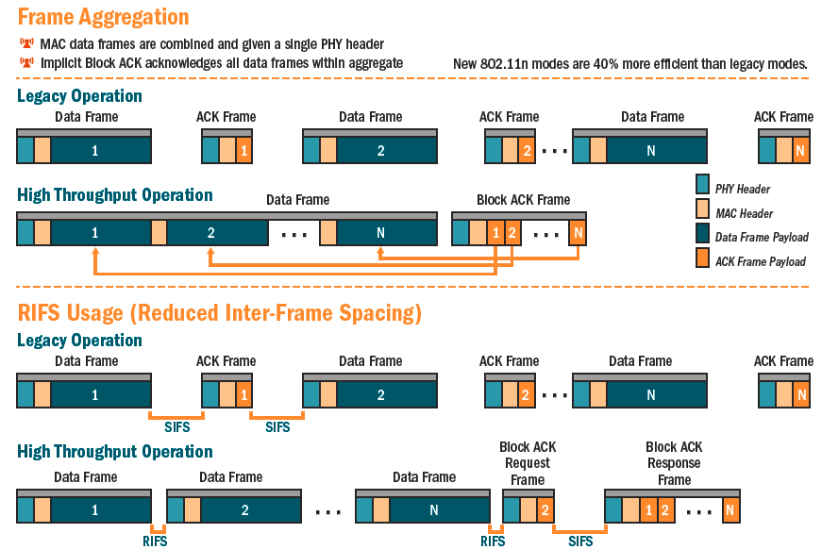
Block ACK Operations

Slide 72
Control Frame - BlockAck

Slide 73
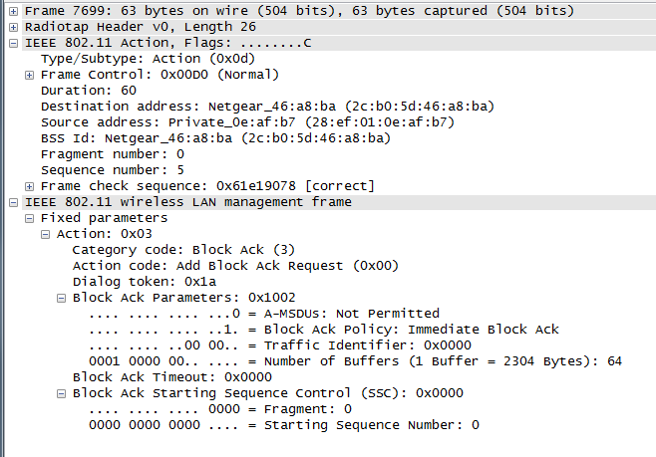
ADDBA Request
Notes:
5G_udp_rx_blockACK.pcap

Slide 74
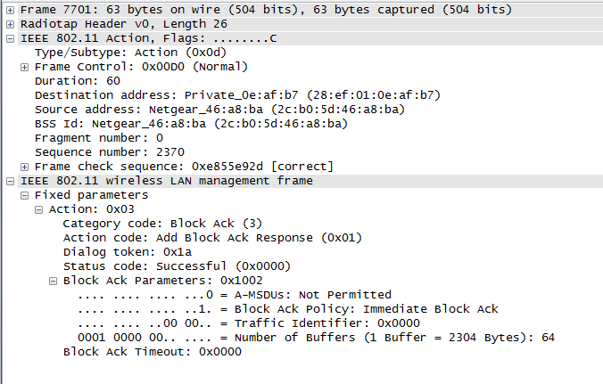
ADDBA Response
Notes:
5G_udp_rx_blockACK.pcap

Slide 75
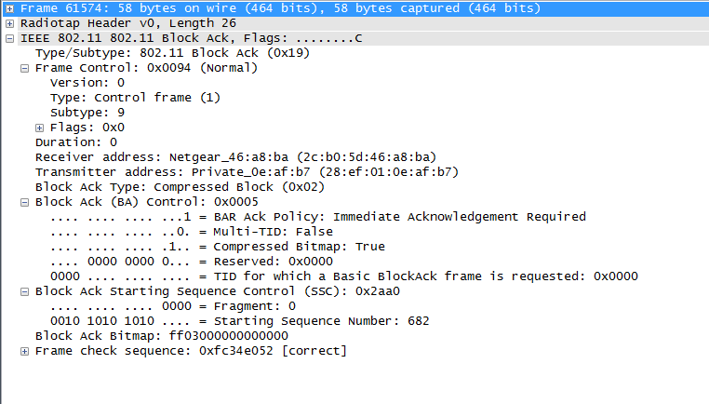
Block-ACK
Notes:
5G_udp_rx_blockACK.pcap

Slide 76
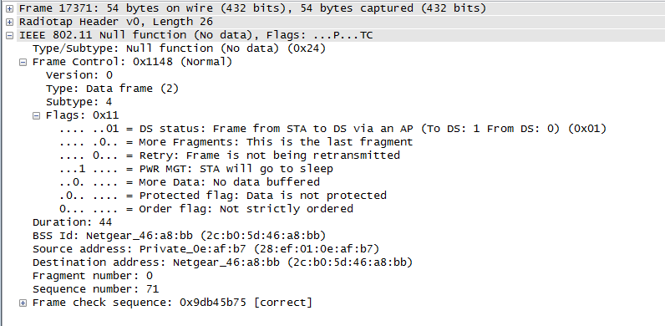
Power Mgmt – Entering PS Mode

Slide 77
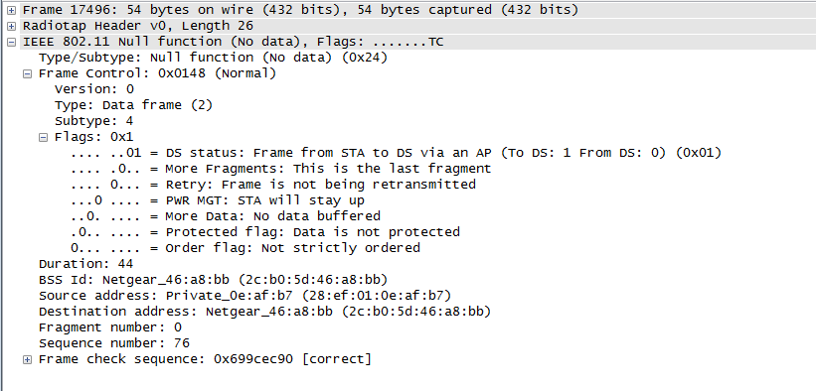
Power Mgmt – Waking Up

Slide 78
Security

Slide 79
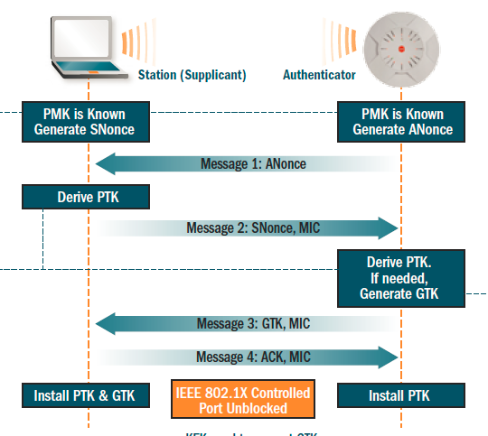
PSK

Slide 80
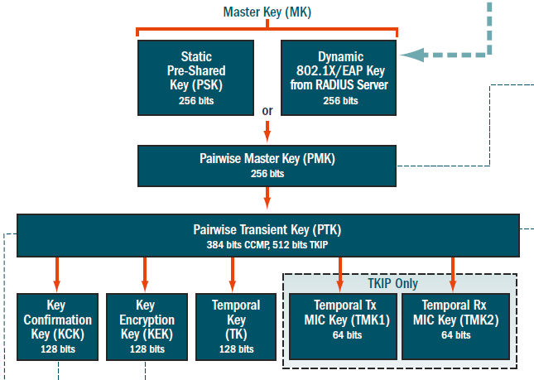
PTK

Slide 81
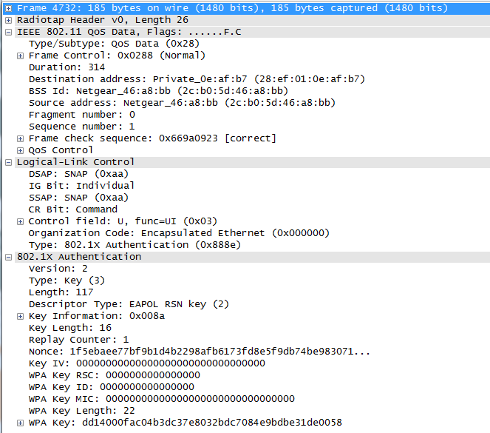
Message 1
Notes:
Wpa2_2.4G-scan-connect-ping-suspend.pcap; Use display filter “eapol”.

Slide 82
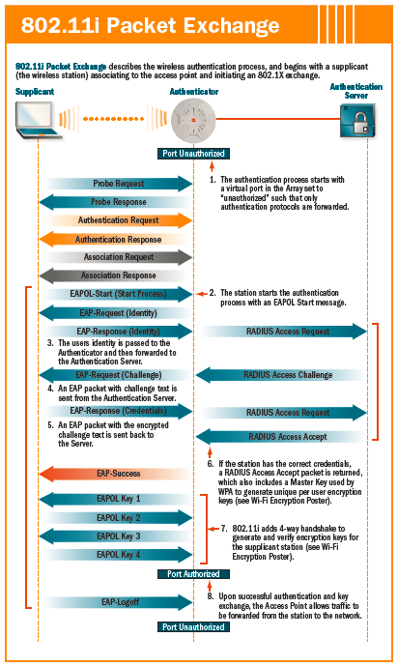

Slide 83
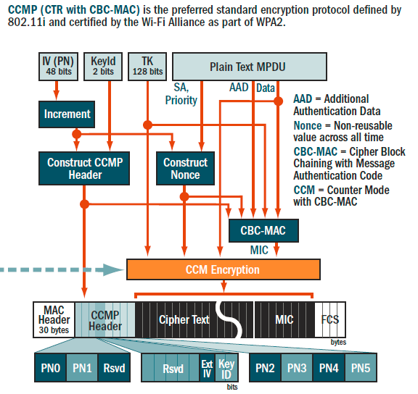
Encryption

Slide 84
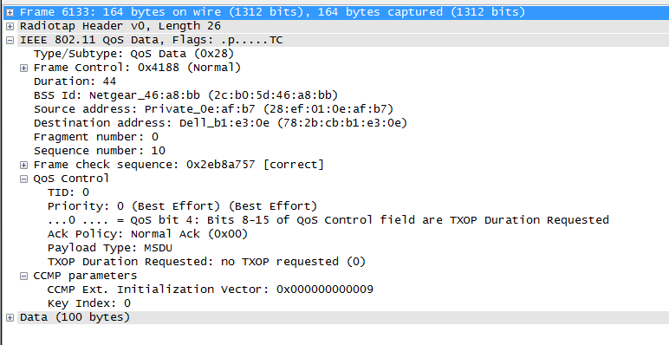
Encrypted Data Frame
This is a PING reply.
So, why did the display filter “ip” and “icmp” fail?
Notes:
wpa2_2.4G-scan-connect-ping-suspend.pcap

Slide 85
PHY

Slide 86
Topics in PHY
Data Rates
Modulations & Coding
OFDM
MIMO

Slide 87
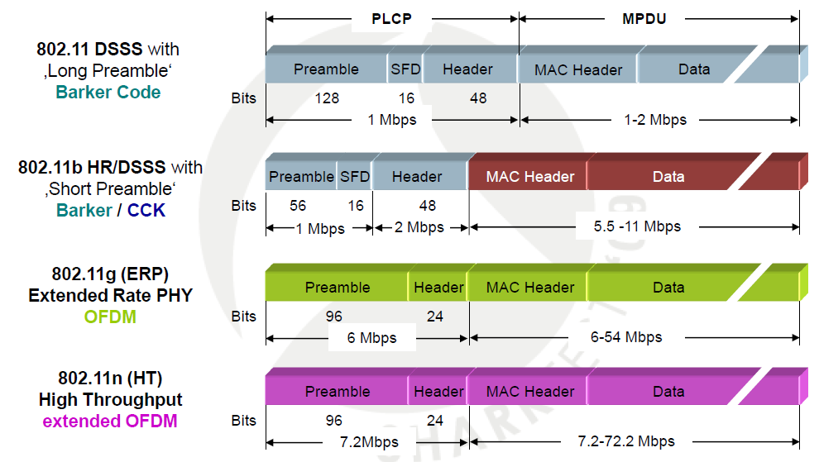
PHY Frame Structure (2.4 GHz)

Slide 88
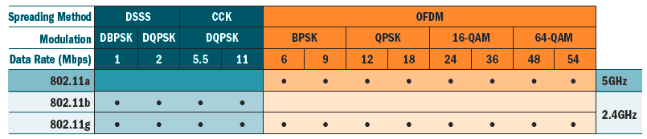
Data Rate & Modulation – 802.11 a/b/g

Slide 89
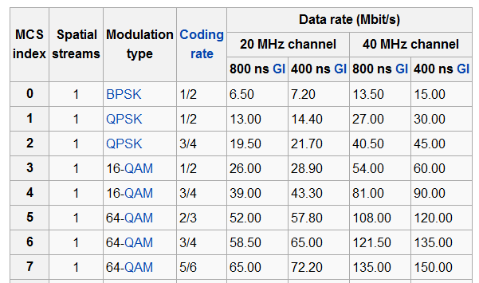
Data Rate & Modulation – 802.11 n, 1x1:1

Slide 90
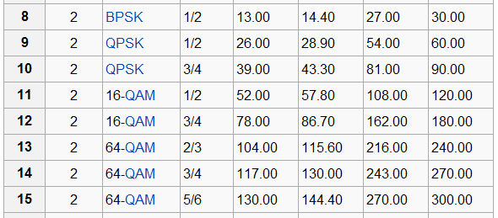
Data Rate & Modulation – 802.11 n, 2x2:2

Slide 91
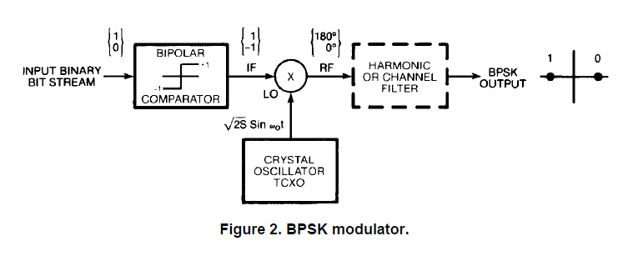
BPSK

Slide 92
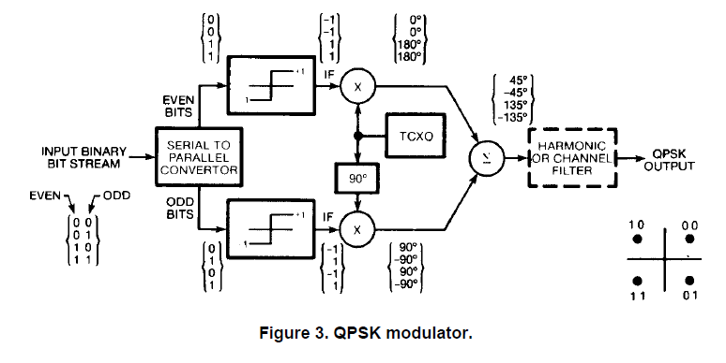
QPSK

Slide 93
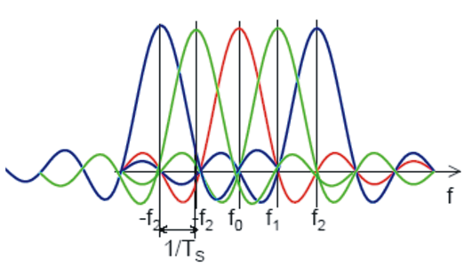
OFDM - Multiplexing

Slide 94
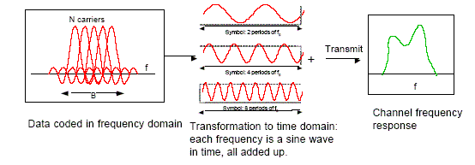
OFDM - Modulation

Slide 95
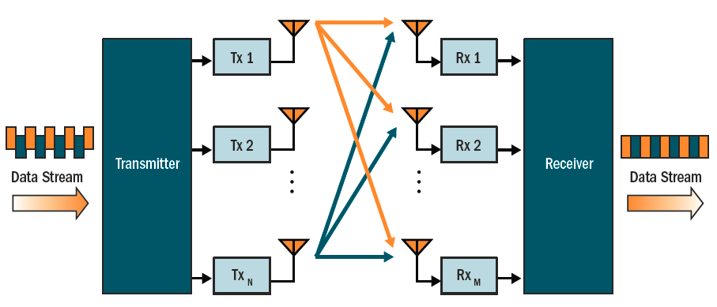
MIMO - Spatial Streams

Slide 96
RF

Slide 97
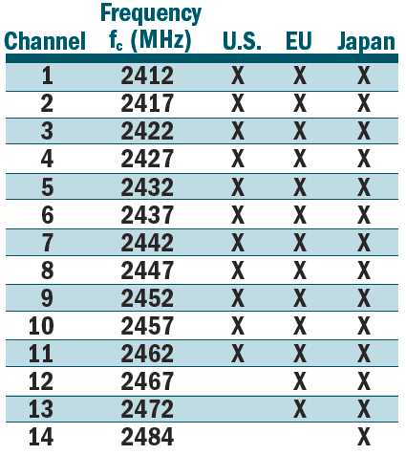
2.4 GHz Channels

Slide 98
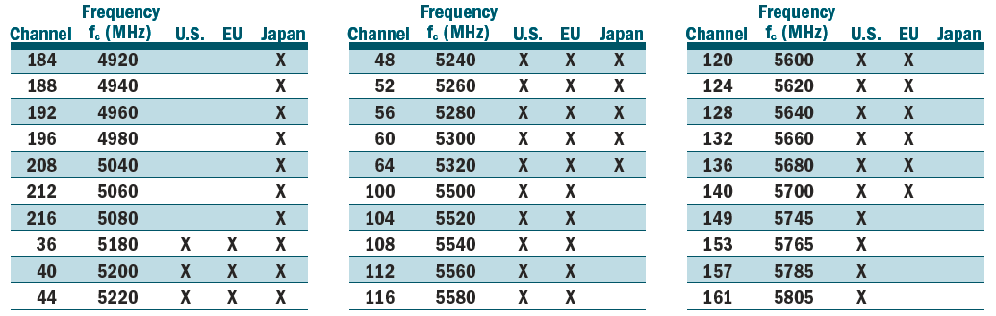
5 GHz Channels
US: DFS required in 5470-5725 MHz U-NII band
US: DFS required in 5260-5320 MHz band

Slide 99
Case studies

Slide 100
Case 1: Dalian Hotel
File: case-DalianHotel.pcap
Observation
At 7AM, there are no data traffic.
Questions
On which channel was this captured?
How many APs are there?
Which are not protected?
Notes:
2.4GHz , Channel 1
2) & 3)
18:b0 – “Intercontinental” (open)– missed a lot of Beacons
18:b1 – “manager” (secured) – MAC is right after “Intercontinental”. Perhaps the same physical AP. Notice sequence number is in-sync with “Intercontinental”
2a:d0 – “Intercontinental” (open)
2a:d1 – “manager” (secured)

Slide 101
Case 2: Beijing Airport
File: case-BeijingAirport.pcap
Observation
There are quite a few APs.
Questions
On which channel was this captured?
How many APs are there?
Which are not protected?
Are there APs with the same SSID?

Slide 102
Case 3: ARP
File: case-ARP.pcap
Observation
Packets #1 and #3 are both broadcast packets.
Questions
Why is #1 acknowledged?
Why is #3 not acknowledged?

Slide 103
Case 4: Deauth
File: case-Deauth.pcap
Observation
DUT failed to connect.
Questions
Was association successful at some point?
When was DUT rejected?
Why was it rejected?

Slide 104
Case 5: Ping
File: case-Ping.pcap
Observation
192.168.2.104 pings 192.168.2.111.
Questions
Which one is a wireless station?
How many ping requests were not answered?
How many packets will be reported as “loss” by the PING app on 192.168.2.104?
Why were they lost?

